Slide 1
AAC Project Two

Slide 2

Purpose
With this project we will attempt to answer the following question
“Does living in a non-urban area put you less at risk with regards to Covid-19?”
-How did we define Urban and Non-Urban?

Slide 3

Tech Stack
Scala
HDFS
Apache Spark
Hive
Zeppelin
Tableau
Github
SBT

Slide 4

Big Blockers
Some of the blockers we met along the way are
-Software Issues
-Coding Problems
The Magic Solution to our Coding Problems
“Learning Spark Lightning-Fast Data Analytics”

Slide 5
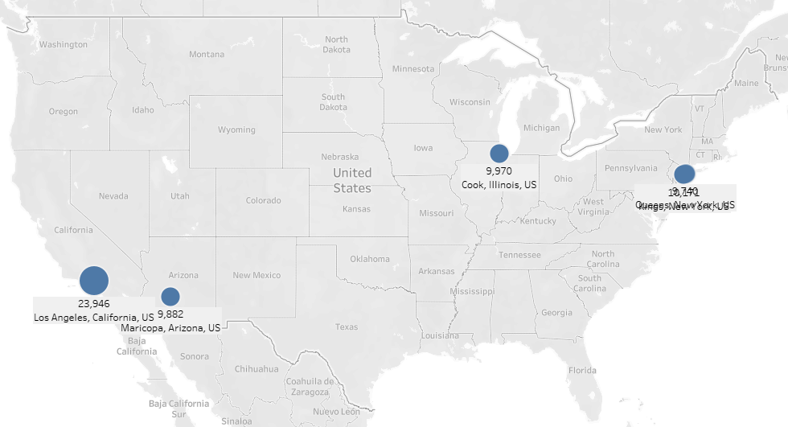
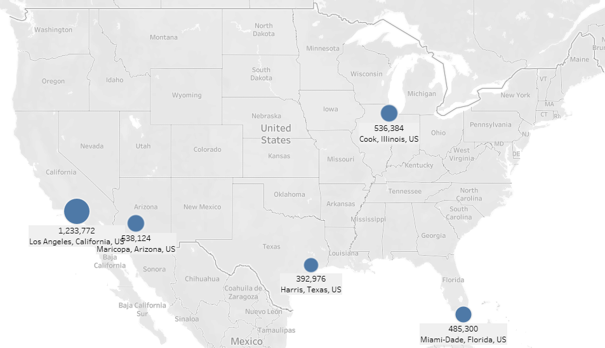
Top 5 Urban Areas Deaths vs Cases

Slide 6
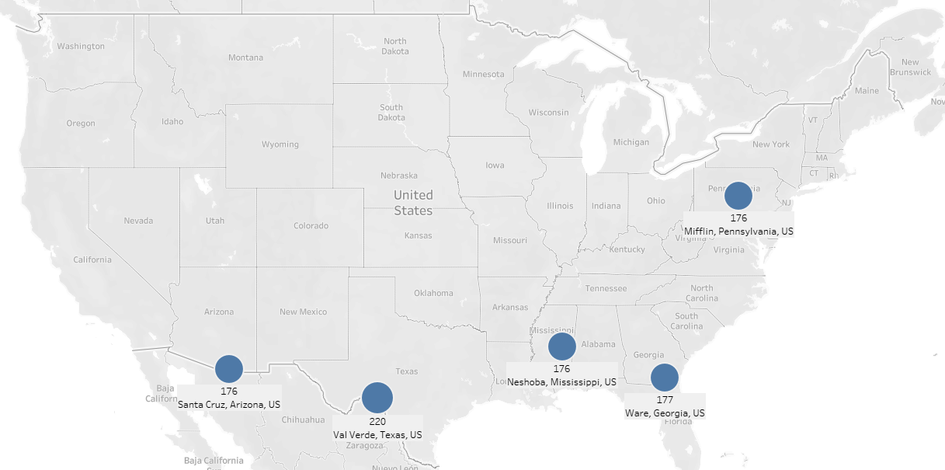
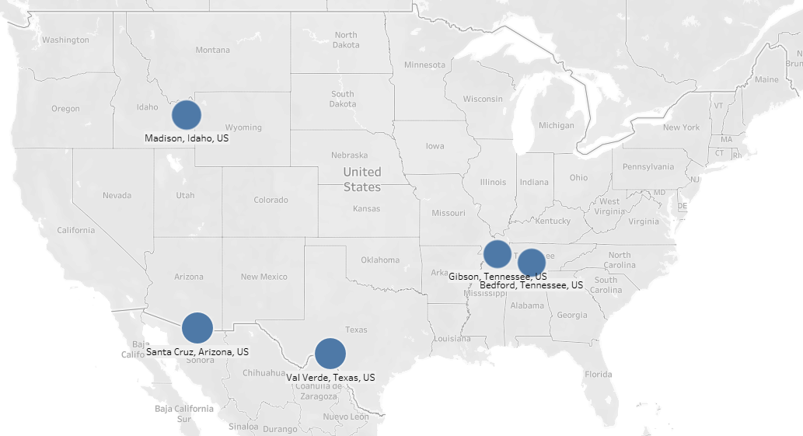
Top 5 Non-Urban Areas Deaths vs Cases

Slide 7

Why we chose to use deaths as the primary data source

Slide 8
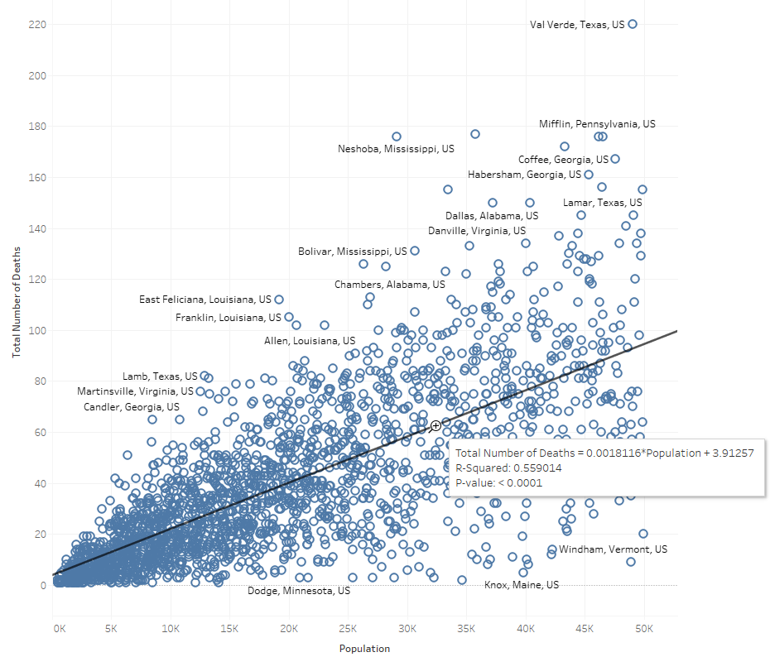
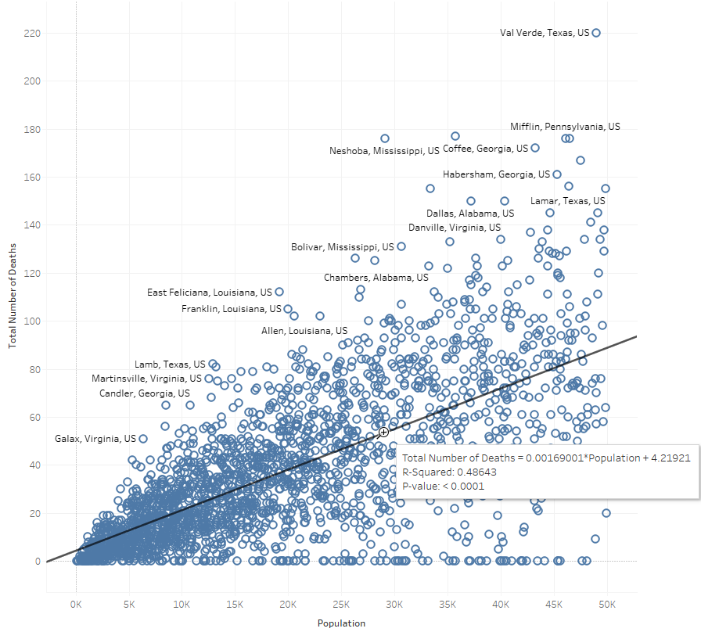
Total Deaths for All Non-Urban Areas
The trend line drawn shows an R-squared value of 0.55
What does this tell us?

Slide 9
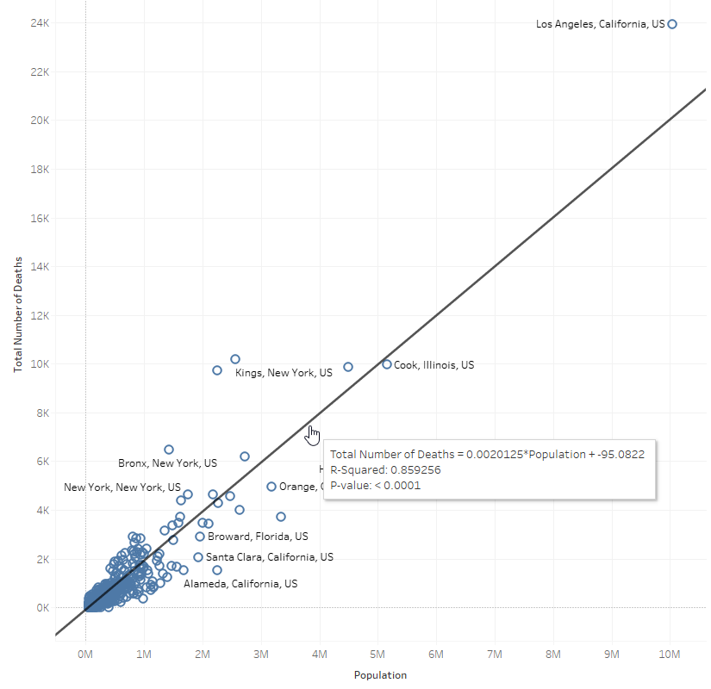
Total Deaths for All Urban Areas
The trend line drawn shows an R-squared value of 0.859
What does this tell us?

Slide 10
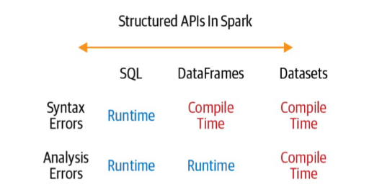
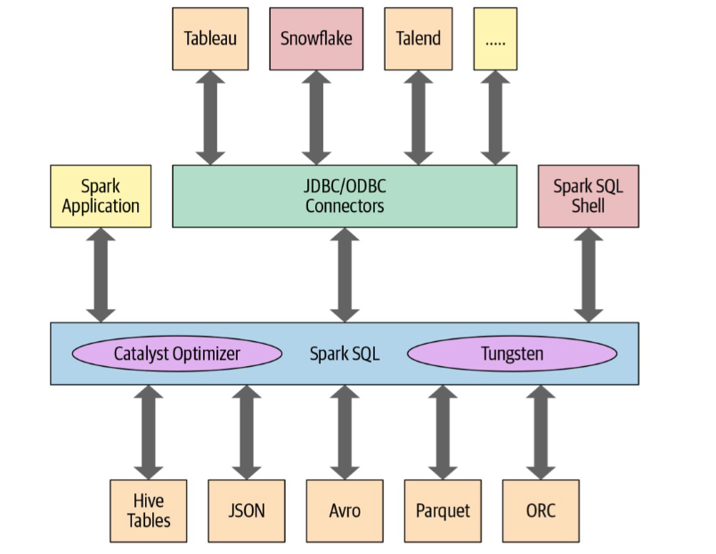
Helping understand how to tackle the problem

